Slide 1
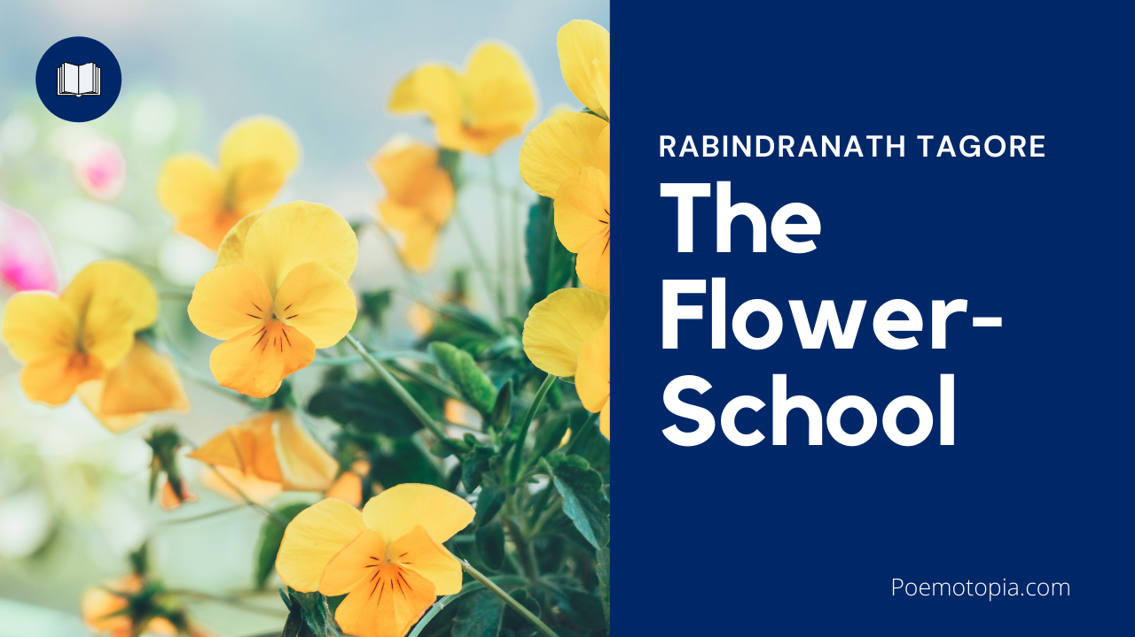

Slide 3
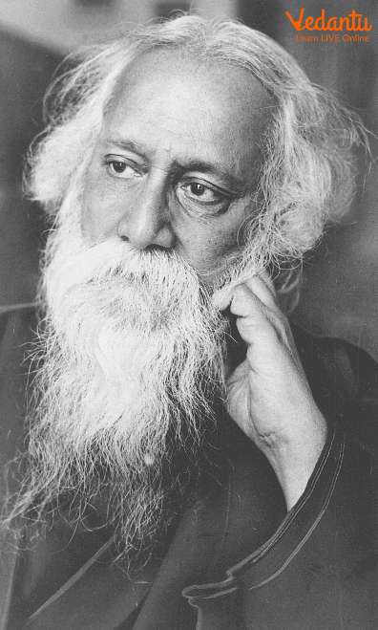
Introduction:
Rabindranath Tagore is a famous Bengali author who won India's first (and so far only) Nobel Prize in Literature. The poet conveys the delight and excitement of the blossoming of flowers with the advent of rains through the naive eyes of a school-aged youngster. Everyone's heart is touched by the innocent depiction of the seasonal appearance and departure of flowers on and off the face of the earth. This short poem depicts a child's interest in flowers, her fear of school, and her love for her mother with remarkable realism. This is why this short poem has its timeless appeal.

Slide 5
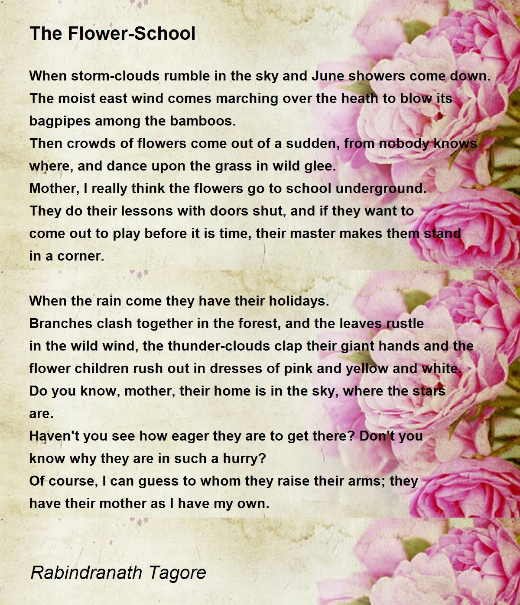

Slide 7
